Slide 1
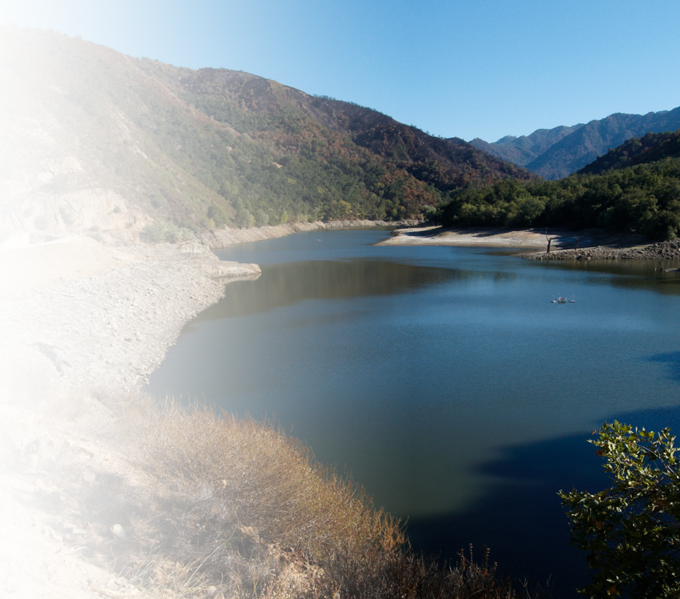
Monterey Peninsula Water Supply Project Update
California American Water
1

Slide 2
California American Water - Monterey
California American Water’s Central Division, based in Pacific Grove, is proud to provide reliable water service to our over 40,000 connections serving roughly 100,000 customers.
680
Miles of infrastructure – enough pipe to reach Arizona
100
Water Storage Tanks
95+
Local employees who are members of our communities
FOR INTERNAL USE ONLY – CONFIDENTIAL AND PROPRIETARY – DRAFT

Slide 3
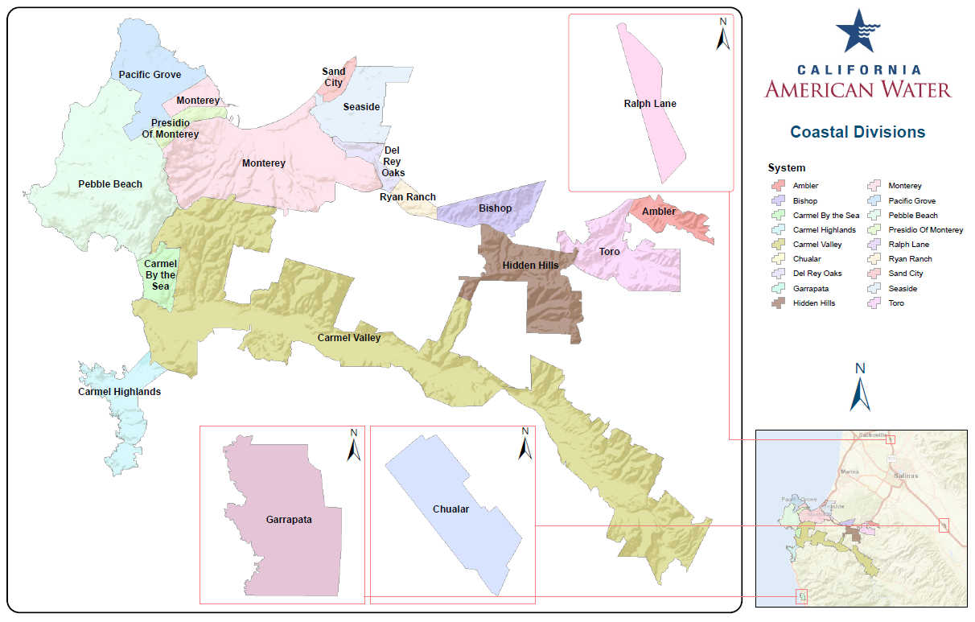
Central Division – Water Systems
Basins within Service Area:
Seaside Basin
Monterey Subbasin
180/400 Aquifer
Langley Area
FOR INTERNAL USE ONLY – CONFIDENTIAL AND PROPRIETARY – DRAFT

Slide 4
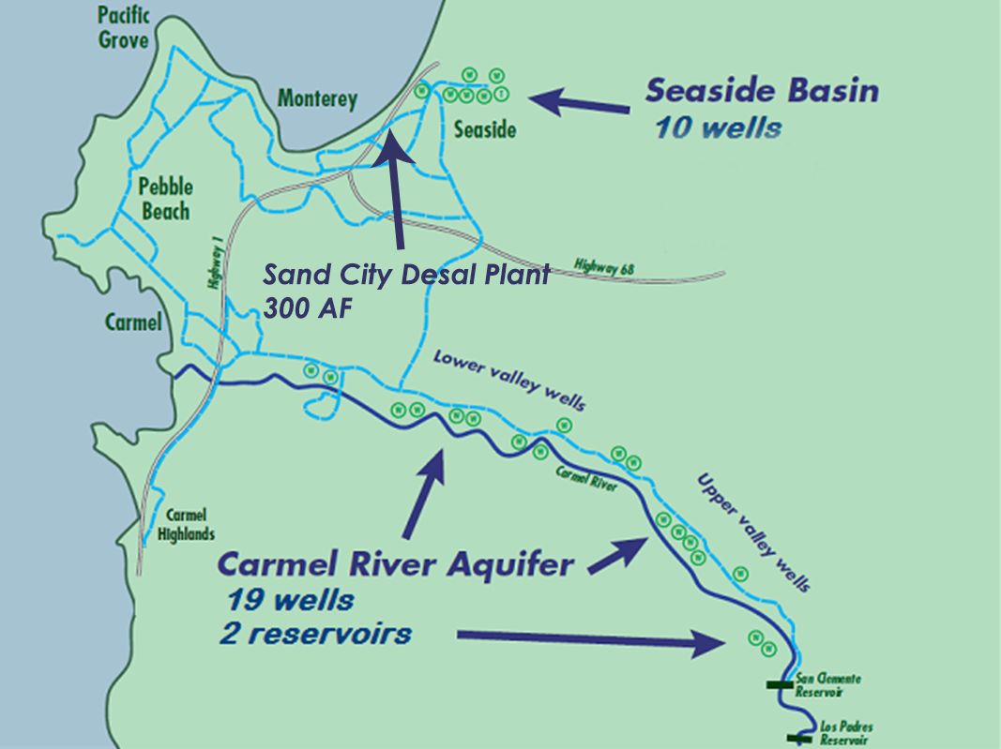
Water Supply Constraints
Carmel River — State ordered withdrawals reduced by more than 50%
Seaside Basin — Court-ordered withdrawal reduction by more than 50%
Drought — Our region is facing increased periods of drought
The required cutbacks to existing supplies cannot be met without replacement water sources
FOR INTERNAL USE ONLY – CONFIDENTIAL AND PROPRIETARY – DRAFT

Slide 5
Today’s Supplies at a Critical Juncture
CURRENT SUPPLIES ~ 8,500 AF
Assumes WY22/23 drought and includes PWM, Carmel, Seaside Basin, Sand City
ASR
Need sufficient long-term supplies to address critical needs such as:
Future Demand
Climate Change & Drought
Operation Supply Buffer
Seaside Basin Protection
CURRENT DEMAND ~ 9,200 AFY
Dependent on limited ASR bank
FOR INTERNAL USE ONLY – CONFIDENTIAL AND PROPRIETARY – DRAFT

Slide 6
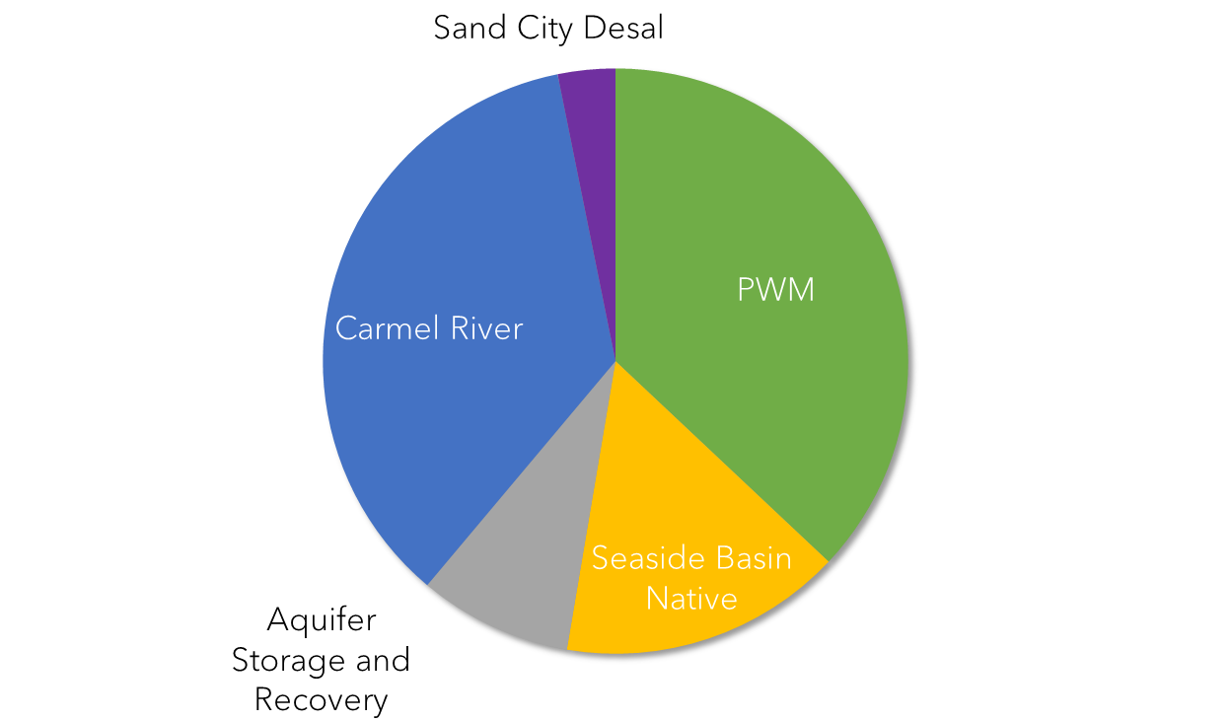
Sources: Past, Present & Future
Show glass of water
Desal
ASR
ePWM
HISTORIC SOURCES
CURRENT SOURCES
FUTURE SOURCES
FOR INTERNAL USE ONLY – CONFIDENTIAL AND PROPRIETARY – DRAFT

Slide 7
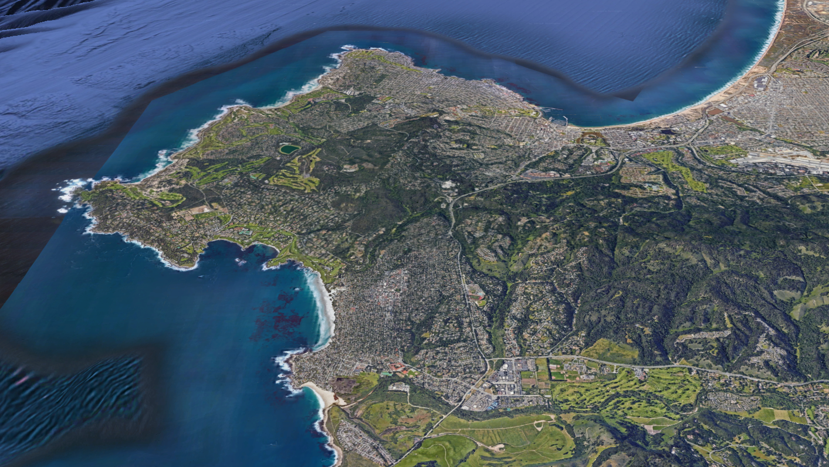
Recent Water Supply Projects
Rain Collection
Desalination
Reuse
Pure Water Monterey
Sand City Desal
Seaside Basin
Aquifer Storage Recovery
Carmel River
Notes:
Carmel River seaside basin and then all that + ASR Then add sand City desal (photo of r/o trains) Then add PWM to Sand City NO MPWSP

Slide 8
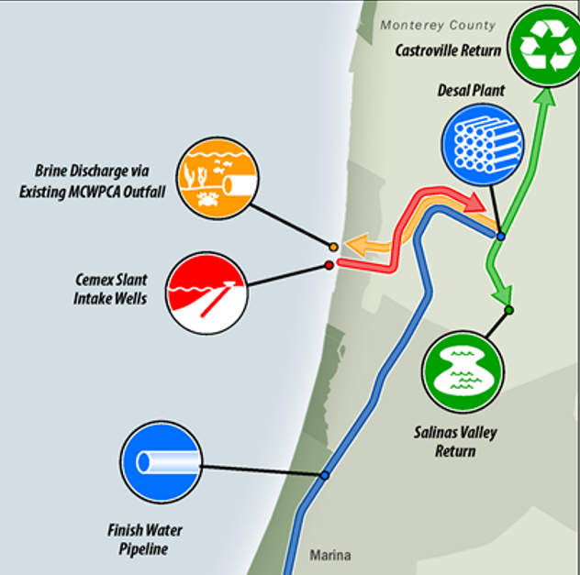
Monterey Peninsula Water Supply Project – Path Forward
Climate Resilience
Droughtproof ability to preserve Carmel River habitat
Environmental Considerations
Carbon free energy
Slant wells
Existing outfall
Affordability
Affordable housing
Customer Assistance, Crisis Assistance, LIHWAP and CWWAPP
Regional Approach
Return water to Castroville
Status and Timeline
California Coastal Commission approval
Expected to be in service by the end of 2027
FUTURE SOURCES
Desal
ASR
ePWM
FOR INTERNAL USE ONLY – CONFIDENTIAL AND PROPRIETARY – DRAFT

Slide 9
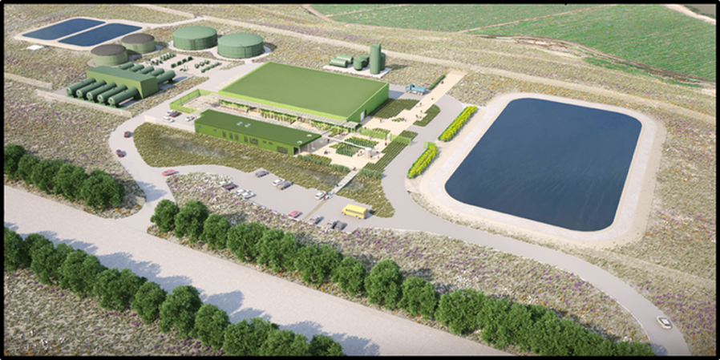
Water Supply Project - Path Forward
CCC Special Conditions
NPDES Permit for Brine Discharge
Outfall Improvements
Dune Habitat Open Space Protection
Design & Procurement
Update Desal Design
Pipeline components bid in 2025
Value Engineering, Pipelines/Plant
Pursuing Cost Savings
Grants (State & Federal)
Low interest loans (SRF)
Customer Affordability Programs
FOR INTERNAL USE ONLY – CONFIDENTIAL AND PROPRIETARY – DRAFT

Slide 10
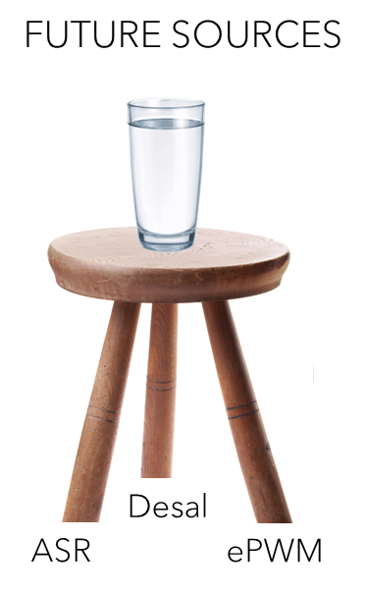
Water Supply Project - Schedule
2024
2025
2026
2027
2028
DESAL
Coastal CDP Prior to Issuance Conditions
Desal Construction Contract Negotiation & Procurement
Desal Construction 24 months
PWM Expansion
Construction and Start-up
FOR INTERNAL USE ONLY – CONFIDENTIAL AND PROPRIETARY – DRAFT

Slide 11
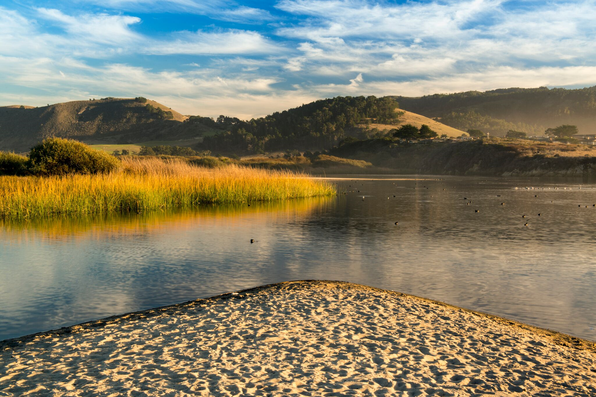
Thank You

